Slide 1

Probability Modelling for Sales Data
By:
Monisha Mallarapu
1001716598

Slide 2
Contents:
Analyzing Data
Correlation
Interactions
Diminishing Returns
Full Model
Hypothesis Testing
Statistics
Selected Model
Predictions
Further Analysis

Slide 3
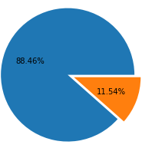
Analysing the Data
xmas = 0
Independent Variables:
Rebate
Amount spent on advertisements
Christmas
Dependent Variables:
Sales
xmas = 1

Slide 4
Season Analysis

Slide 5
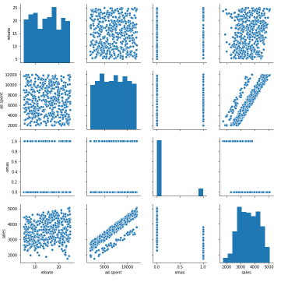
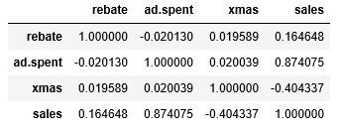
Correlation between variables

Slide 6
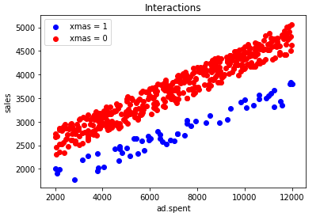
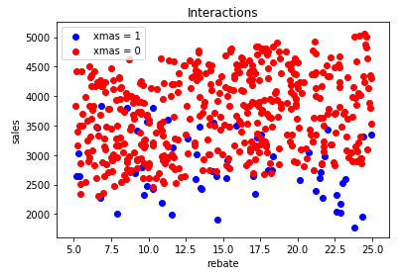
Interactions

Slide 7
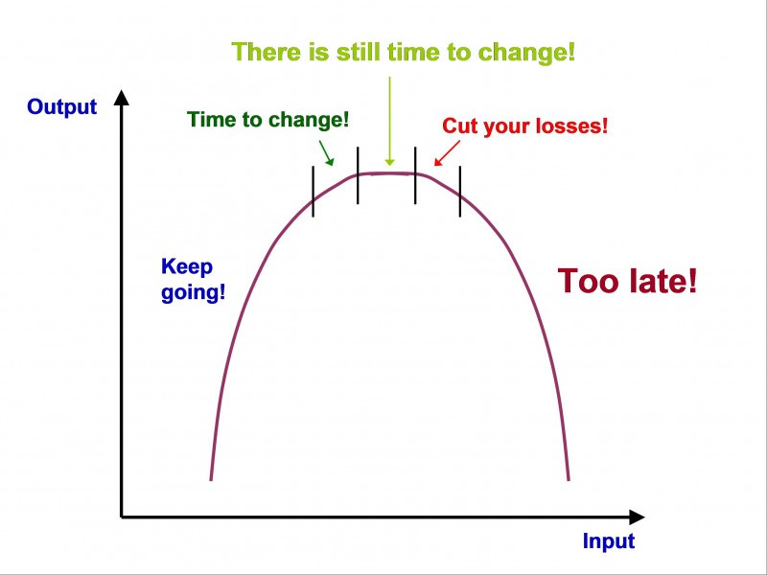
Diminishing Returns

Slide 8
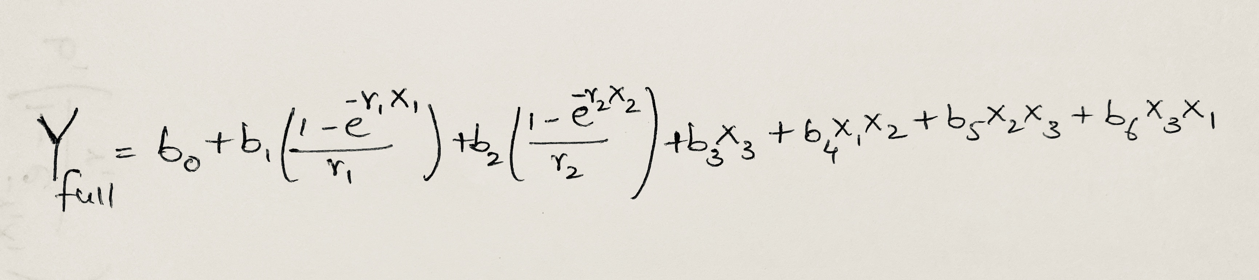
Full Model
X1 – Rebate
X2 – Ad.Spent
X3 – XMAS
Y – Sales

Slide 9
Hypothesis Testing
Hypothesis 0 (H0): Assumption of the test holds and is failed to be rejected at some level of significance.
Hypothesis 1 (H1): Assumption of the test does not hold and is rejected at some level of significance.
Null Hypothesis: b0 = 0
Alternate Hypothesis: b0 != 0

Slide 10

Likelihood
Minimize function from Scipy.Optimize
Coefficients which gives min Sum of Squared Residuals
Calculate Log Likelihood using the formula:
$l(a,b,r|\vec{x},\vec{y})=−\frac{n}{2}\{log⁡(\sum_{i=1}^{n}{{\left(y_{i}−f\left(x_{i} | a,b,r\right)\right)}^{2})+1+log\left(2π\right)−log⁡(n)\}}$
Perform Likelihood Ratio Test
LRT = 2(l_{full}(a,b,r) – l_{restricted}(a,b,0))
Calculate P-value for each model with LRT
Reject the H_{null} if the P < 0.05

Slide 11
Statistics
Hypothesis | b0 | b1 | b2 | b3 | b4 | b5 | b6 | r1 | r2 | Log Likelihood | LRT | P-value
Full Model | 0.0013 | 0.0029 | 1.2182 | 0.00099 | 0.0036 | -0.1147 | 0.00053 | 0.00199 | 0.000308 | -3615
Hb0 = 0 | 0 | 0.00323 | 1.1034 | 0.00099 | 0.0035 | -0.1596 | 0.000434 | 0.00199 | 0.000263 | -3672 | 114.6 | 0
Hb1 = 0 | 0.00133 | 0 | 1.1034 | 0.00099 | 0.0035 | -0.1597 | 0.000434 | 0 | 0.000263 | -3672 | 114.62 | 0
Hb2 = 0 | 158.6595 | 1040.635 | 0 | 4.5123 | 0.009201 | 0.13345 | -130.922 | 0.39759 | 0 | -3829 | 428.56 | 0
Hb3 = 0 | 0.001266 | 0.002902 | 1.1783 | 0 | 0.00355 | -0.11482 | 0.000546 | 0.00199 | 0.000294 | -3616 | 3.47 | 0.0625
Hb4 = 0 | 0.001735 | 0.01199 | 1.1855 | 0.00099 | 0 | -0.1144 | 0.000969 | 0.001775 | 0.000252 | -3693 | 157.78 | 0
Hb5 = 0 | 0.39262 | 4.1303 | 1.335 | -3.54264 | 0.004717 | 0 | -0.61315 | 5.525 | 0.000364 | -3827 | 424.436 | 0
Hb6 = 0 | 0.001266 | 0.0029 | 1.177 | 0.00099 | 0.003548 | -0.1148 | 0 | 0.00199 | 0.00029 | -3616 | 3.55 | 0.0595
Hr1 = 0 | 4.5353 | 0.1695 | 10715 | -1.066 | 0.00353 | -0.03878 | -43.2109 | 0 | 5.0154 | -4458 | 1687.19 | 0
Hr2 = 0 | 116.322 | 0.22216 | 0.22216 | 9.09137 | 0.00176 | -0.2617 | 76.3894 | 0.002 | 0 | -4646 | 2063.8 | 0

Slide 12
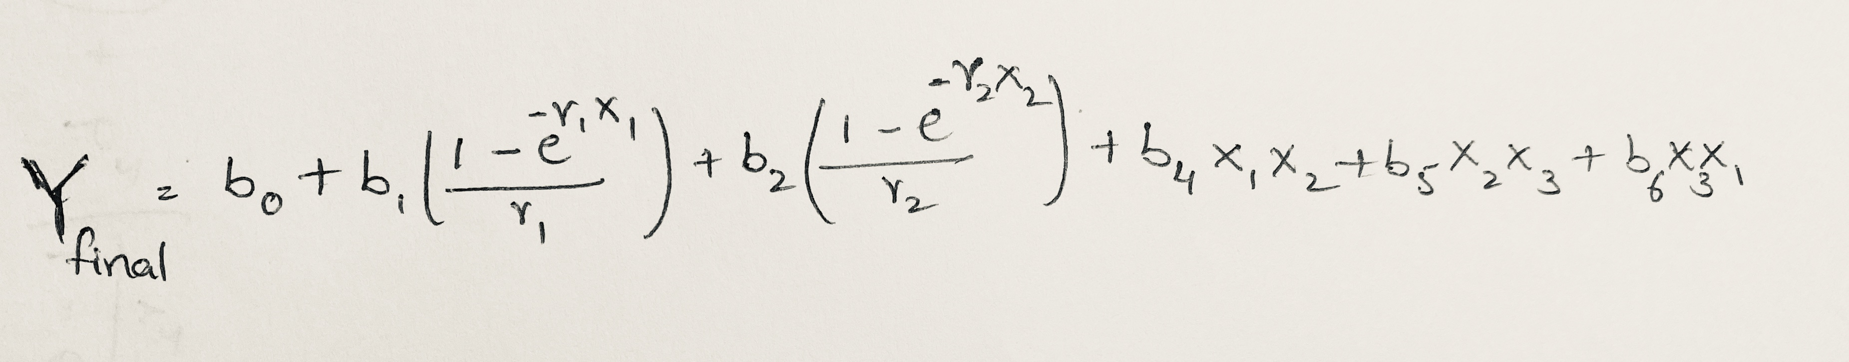
Selected Model
X1 – Rebate
X2 – Ad.Spent
X3 – XMAS
Y – Sales

Slide 13
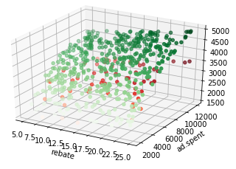
Predictions

Slide 14

Further Analysis

Slide 15

Questions?

